Slide 1
One more Python notebook to fetch this week

Slide 2
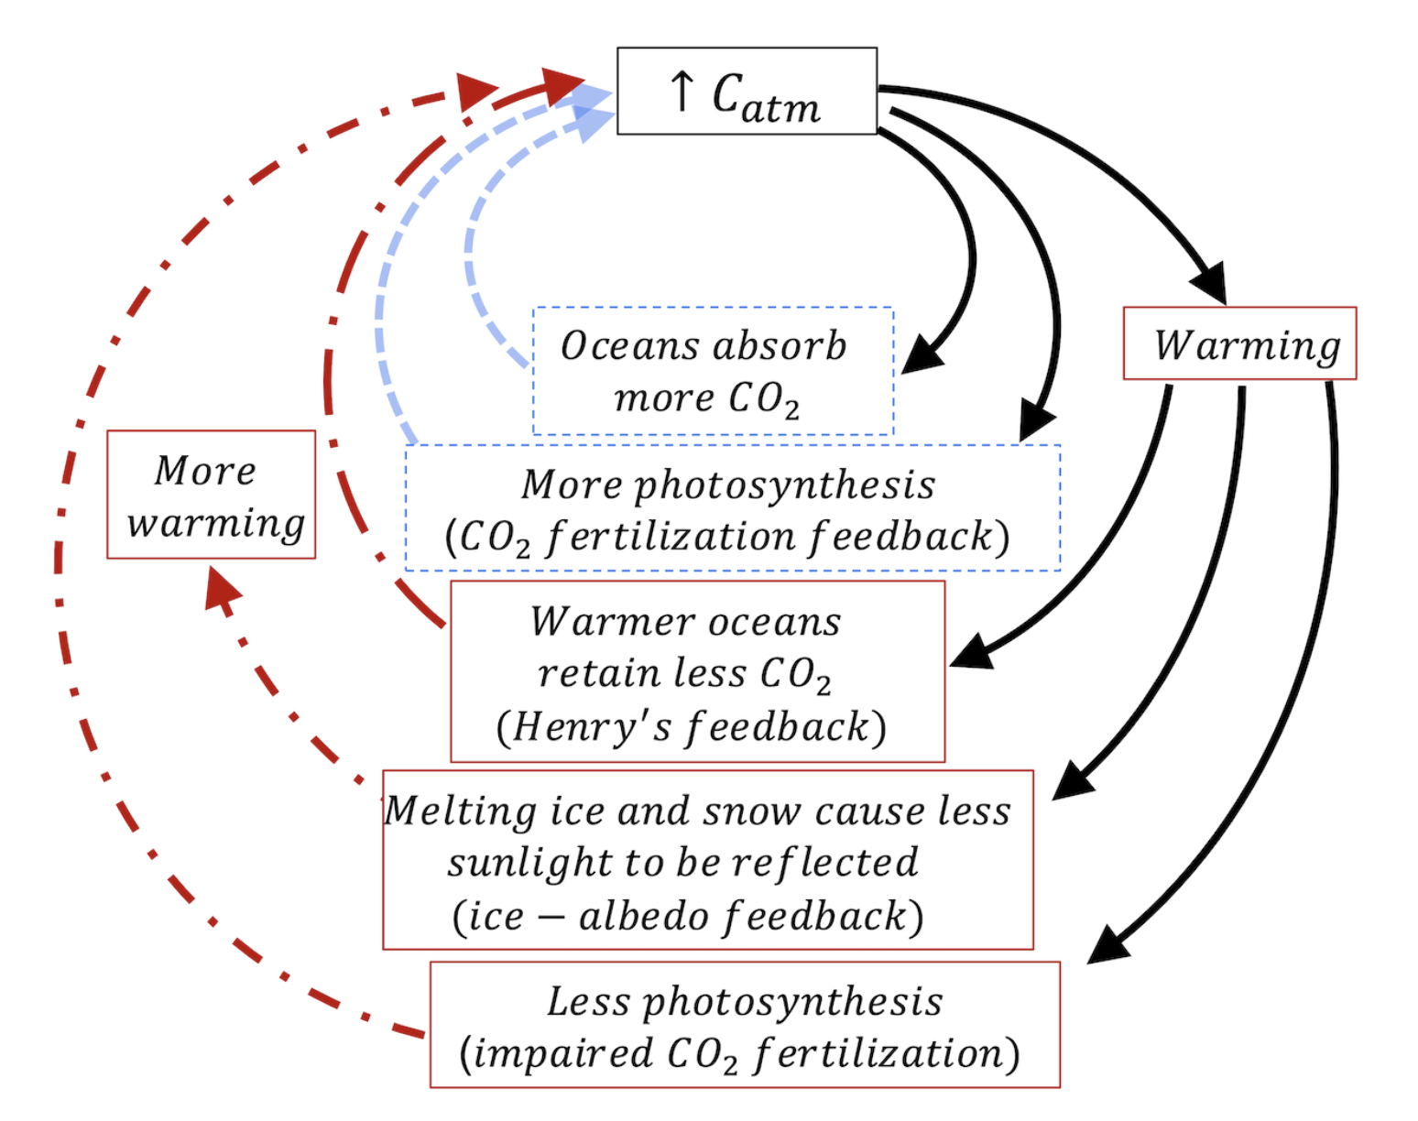
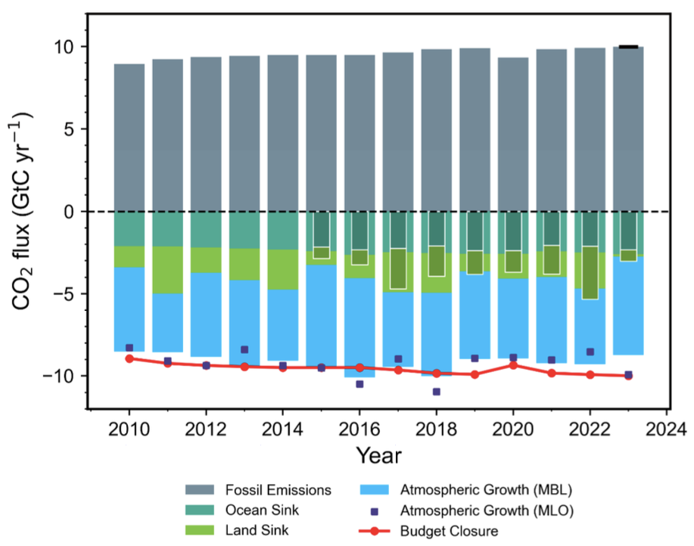
Ke et al are saying that $CO_{2}$ fertilization is impaired at higher temperatures
Ke et al’s Carbon budget from 2010-2023.

Slide 3
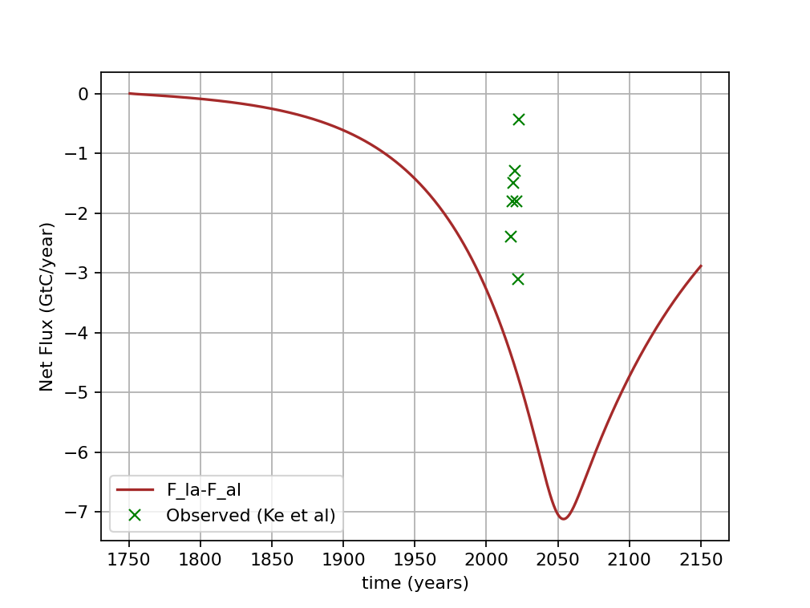
The inadequacy of Cambio 3 to reproduce Ke et al’s results
Ke et al’s Carbon budget from 2010-2023.
Terrestrial carbon ecosystem service we expected

Slide 4
The inadequacy of Cambio 3 to reproduce Ke et al’s results
Ke et al’s Carbon budget from 2010-2023.
Terrestrial carbon ecosystem service reported by Ke et al indicates significant CO₂ fertilization impairment.

Slide 5
The inadequacy of Cambio 3 to reproduce Ke et al’s results
Ke et al’s Carbon budget from 2010-2023.
Terrestrial carbon ecosystem service reported by Ke et al indicates significant CO₂ fertilization impairment.
Ke et al trace the CO₂ fertilization impairment to the Amazon.

Slide 6
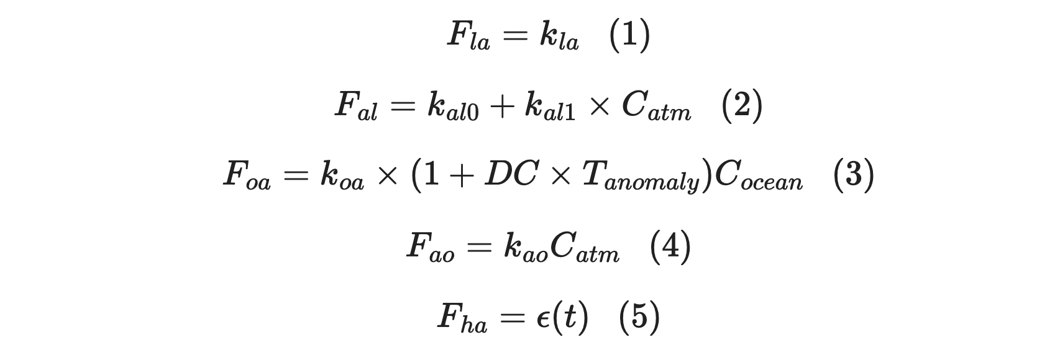
We can implement $CO_{2}$ fertilization impairment using a sigmoid factor in Eq. 2
Cambio 3

Slide 7
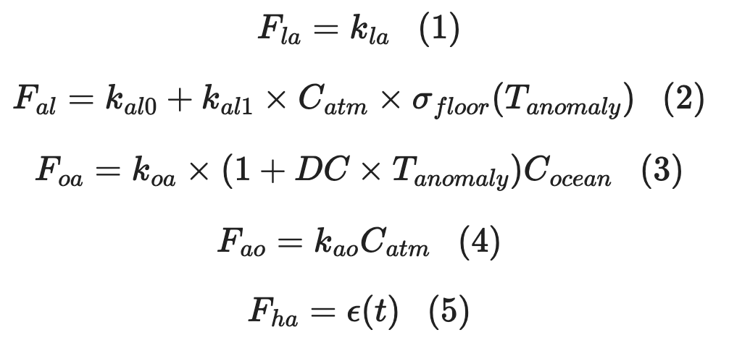
We can implement $CO_{2}$ fertilization impairment using a sigmoid factor in Eq. 2
Cambio 4

Slide 8
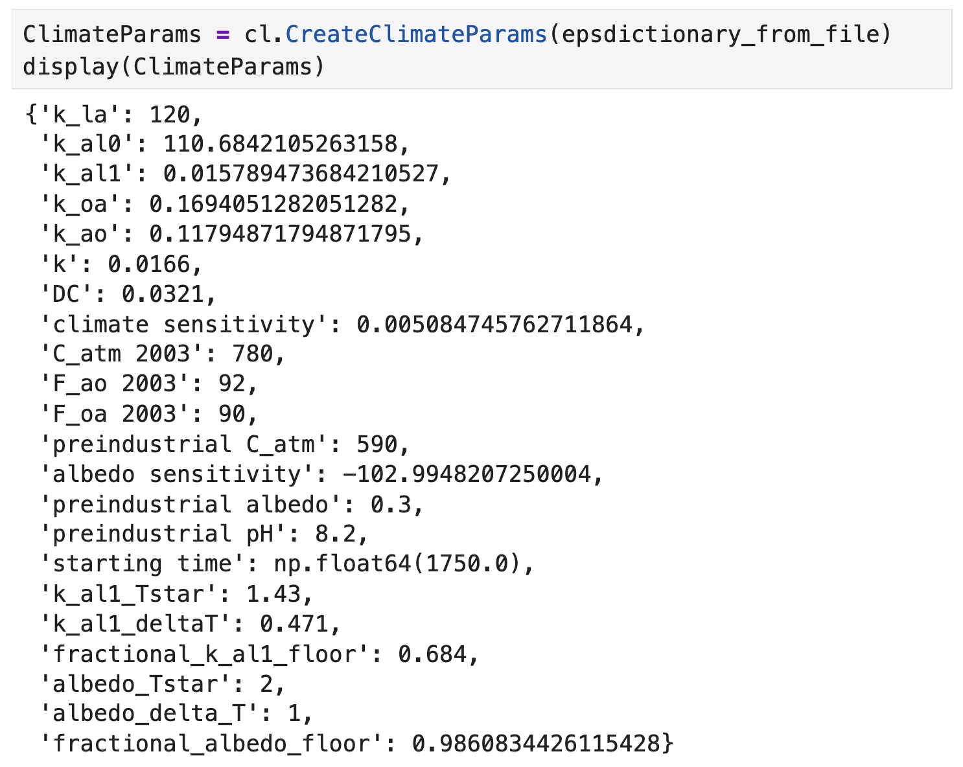
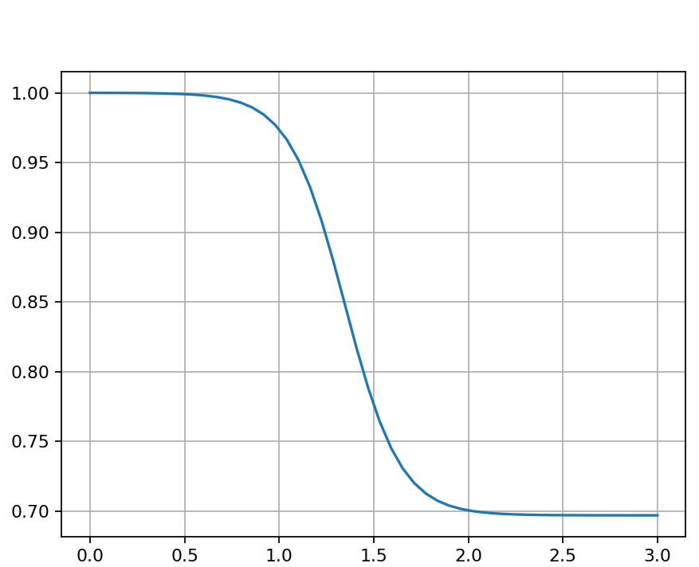
Parameters of the sigmoid function have been set to match Ke et al’s data

Slide 9
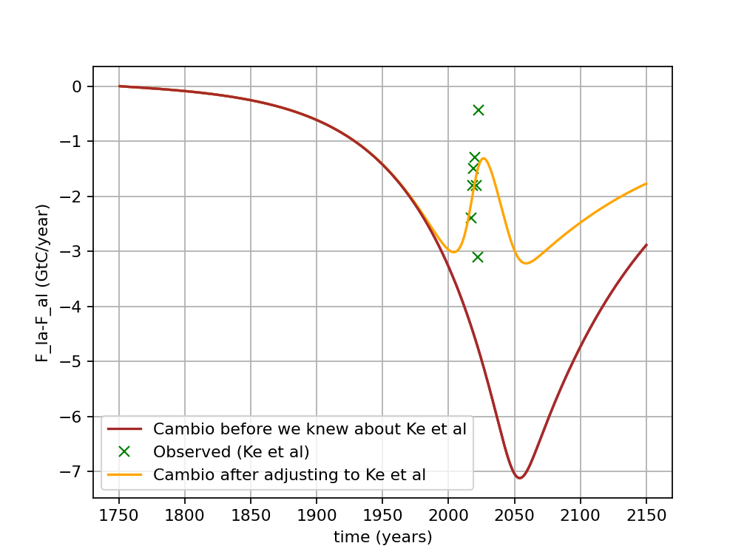
Cambio 3 vs Cambio 4 results
Ke et al’s Carbon budget from 2010-2023.

Slide 10
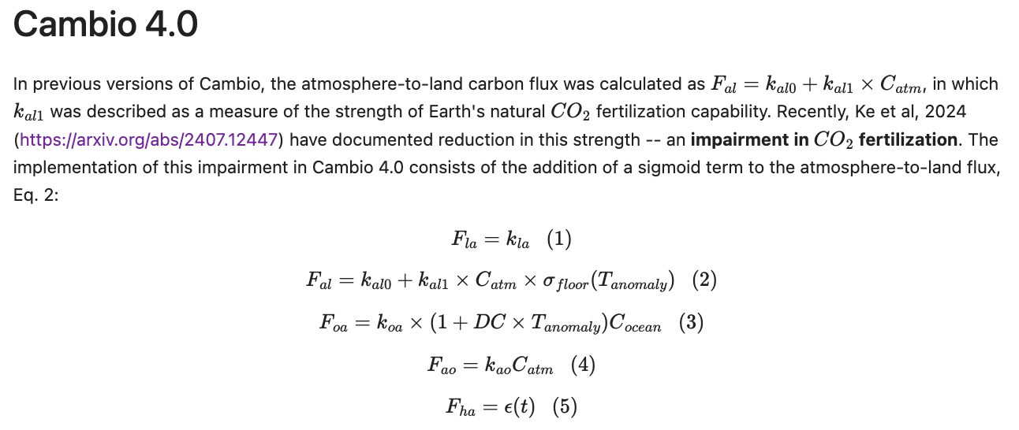
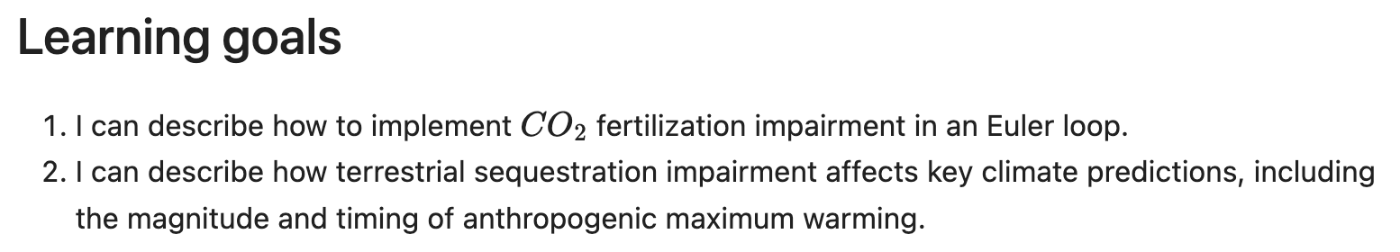
OK, let’s get started

